Slide 1



Insurance project
View in Power BI
Last data refresh:
11/12/2024 8:59:54 AM UTC
Downloaded at:
11/15/2024 6:33:57 AM UTC

Slide 2
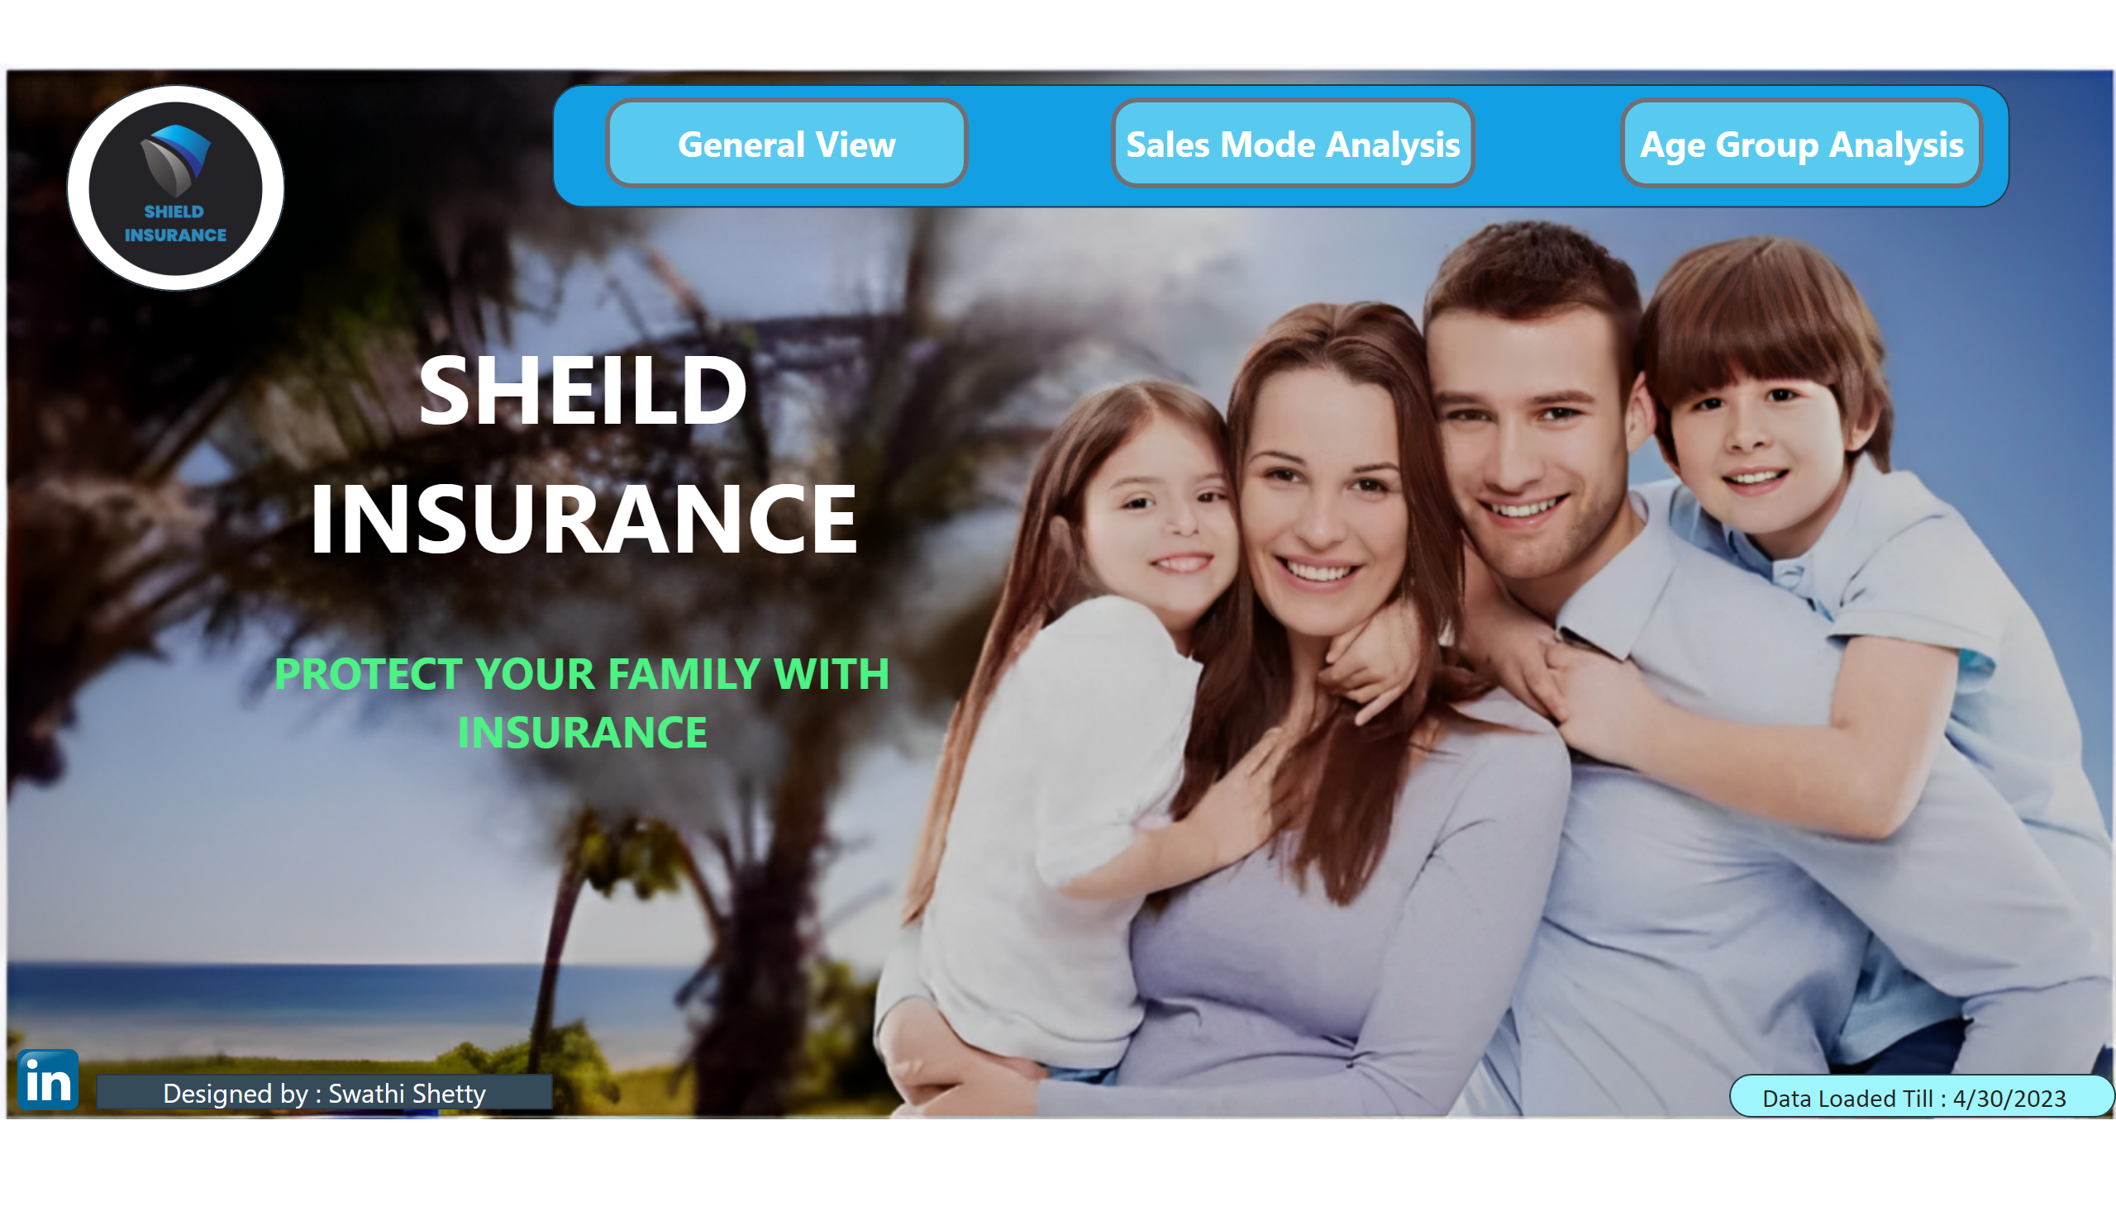
Home
Notes:
shape
No alt text provided
shape
No alt text provided
actionButton
No alt text provided
actionButton
No alt text provided
actionButton
No alt text provided
image
No alt text provided
shape
No alt text provided
shape
No alt text provided
textbox
No alt text provided
image
No alt text provided
shape
No alt text provided
card
No alt text provided

Slide 3
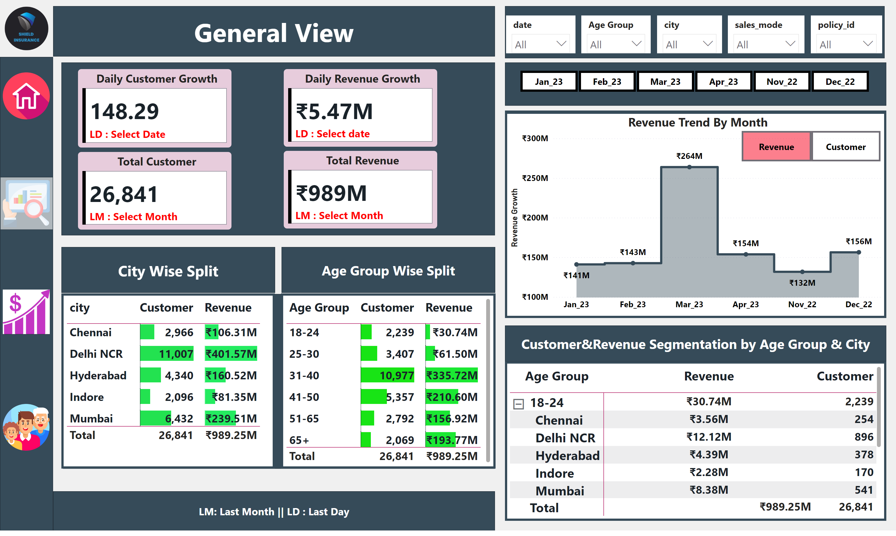
General_View
Notes:
shape
No alt text provided
image
No alt text provided
shape
No alt text provided
shape
No alt text provided
Customer Trend by Month
No alt text provided
actionButton
No alt text provided
Customer button
No alt text provided
Revenue Trend By Month
No alt text provided
shape
No alt text provided
shape
No alt text provided
pivotTable
No alt text provided
shape
No alt text provided
shape
No alt text provided
shape
No alt text provided
tableEx
No alt text provided
tableEx
No alt text provided
shape
No alt text provided
slicer
No alt text provided
slicer
No alt text provided
slicer
No alt text provided
slicer
No alt text provided
slicer
No alt text provided
shape
No alt text provided
image
No alt text provided
Daily Customer Growth
No alt text provided
slicer
No alt text provided
Daily Revenue Growth
No alt text provided
Total Customer
No alt text provided
Total Revenue
No alt text provided
image
No alt text provided
image
No alt text provided
image
No alt text provided
shape
No alt text provided
revenue button highlighted
No alt text provided
actionButton
No alt text provided

Slide 4
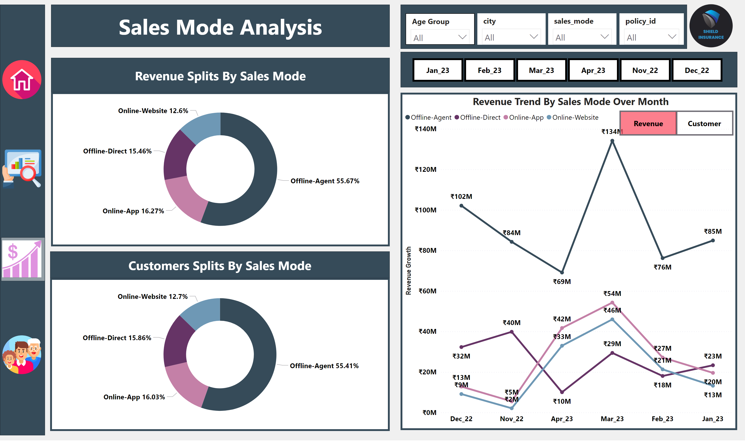
Sales_Mode_Analysis
Notes:
shape
No alt text provided
image
No alt text provided
shape
No alt text provided
shape
No alt text provided
lineChart
No alt text provided
revenue button
No alt text provided
Customer button
No alt text provided
Revenue Trend By Sales Mode Over Month
No alt text provided
shape
No alt text provided
shape
No alt text provided
slicer
No alt text provided
slicer
No alt text provided
slicer
No alt text provided
slicer
No alt text provided
donutChart
No alt text provided
donutChart
No alt text provided
shape
No alt text provided
slicer
No alt text provided
image
No alt text provided
image
No alt text provided
image
No alt text provided
shape
No alt text provided
image
No alt text provided
revenue button highlight
No alt text provided
actionButton
No alt text provided

Slide 5
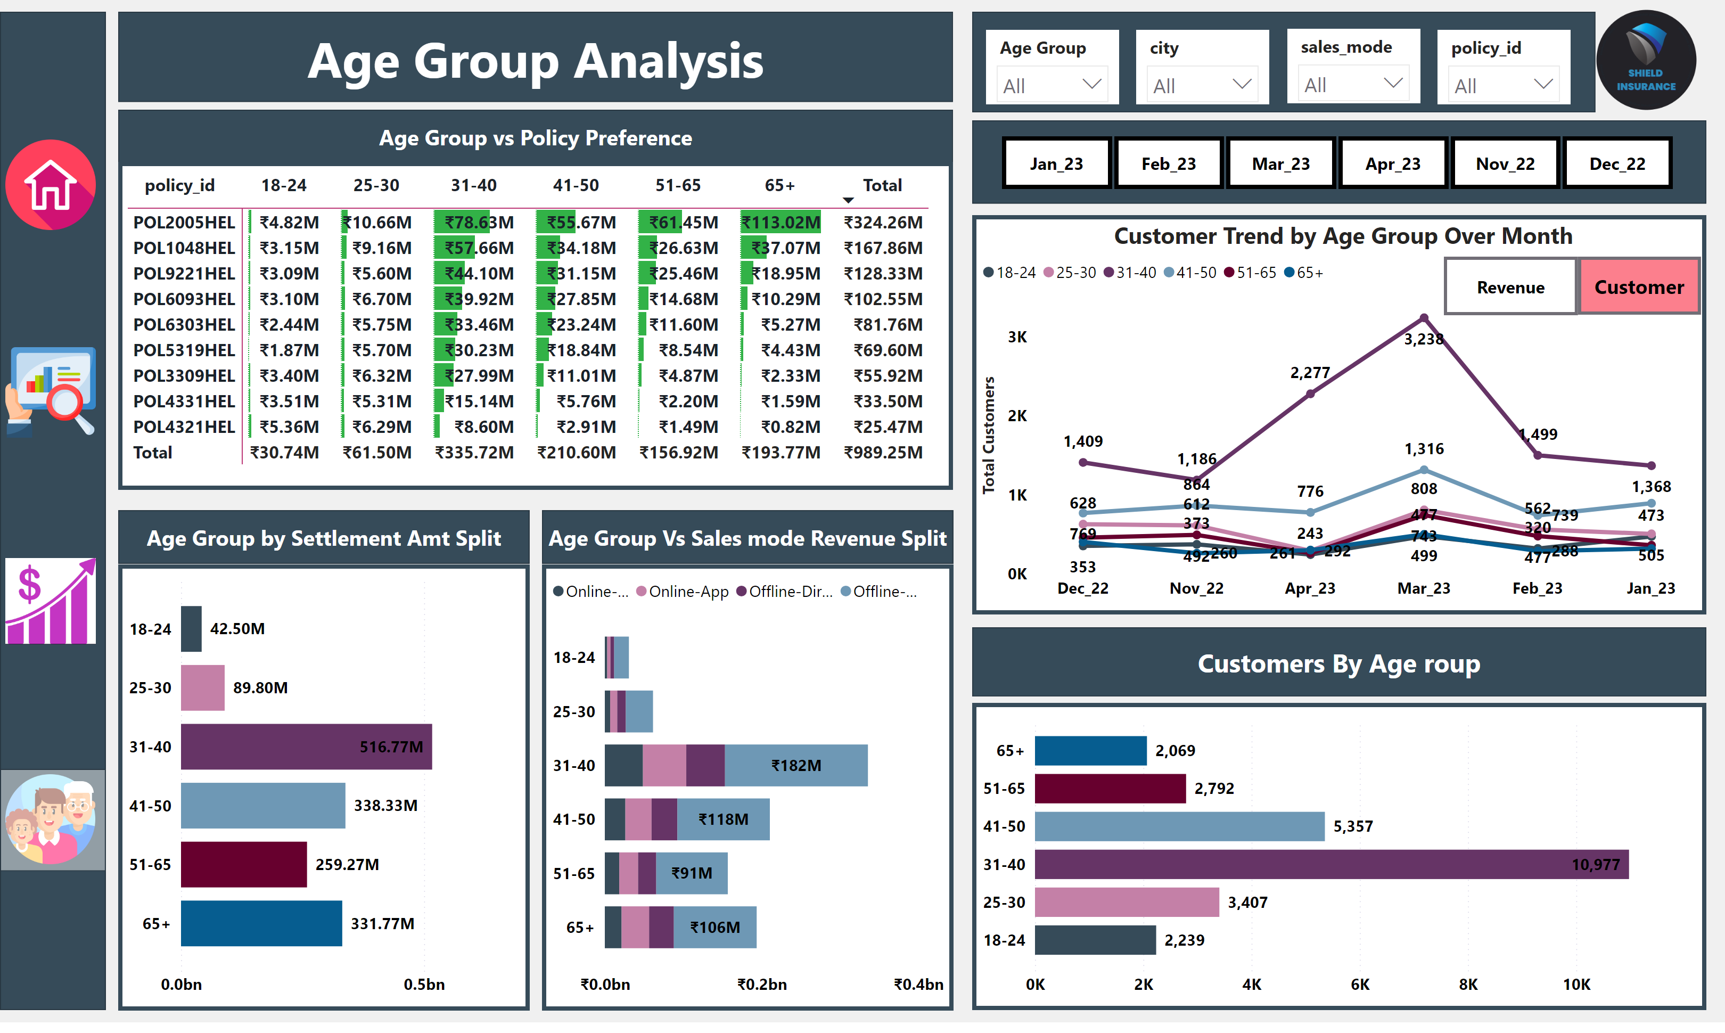
Age_group_Analysis
Notes:
shape
No alt text provided
image
No alt text provided
shape
No alt text provided
Customer Trend by Age Group Over Month
No alt text provided
revenue button
No alt text provided
actionButton
No alt text provided
lineChart
No alt text provided
shape
No alt text provided
shape
No alt text provided
clusteredBarChart
No alt text provided
shape
No alt text provided
shape
No alt text provided
shape
No alt text provided
pivotTable
No alt text provided
barChart
No alt text provided
slicer
No alt text provided
slicer
No alt text provided
slicer
No alt text provided
slicer
No alt text provided
slicer
No alt text provided
barChart
No alt text provided
shape
No alt text provided
image
No alt text provided
image
No alt text provided
shape
No alt text provided
image
No alt text provided
image
No alt text provided
actionButton
No alt text provided
Customer button highter
No alt text provided

